Slide 2
Testing (by) documentation
…or how to maintain your API documentation…
April 2018

Slide 3

Who am I?
Vilim, not Filip
Software Developer @ Degordian
PHP & JS enthusiast
I also love TypeScript.
Jack of all trades
Documentation writer

Slide 4
Documentation?

Slide 5


Slide 19
Documentation
https://apiblueprint.org/
simple
expressive
quick (once you get to know it)
great tools

Slide 20
Why is this not being used by everybody then?

Slide 21
Documentation
maintaining
change logs
is the documentation right?

Slide 22
Dredd
Language-agnostic HTTP API Testing Framework
tests by documentation
Requirements:
documentation
one platform that it supports

Slide 23
I don’t believe you, show me some code!

Slide 24
Drawbacks
“hard” to introduce
edge cases around frameworks
yet another system in our stack

Slide 25
Benefits
one source of truth
parallelism
guideline for QA/mobile
no more outdated docs

Slide 26
Conclusion

Slide 29
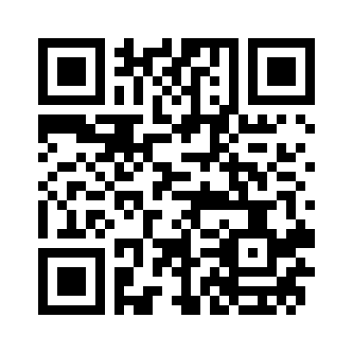
Thank you!
Q&A
Give me feedback, please
http://bit.ly/2GQER8V
April 2018

